Slide 1
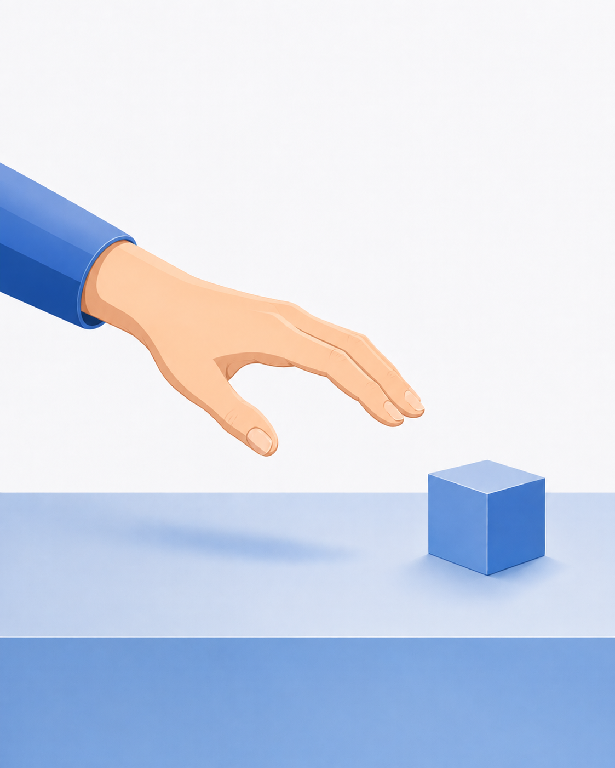

Slide 2
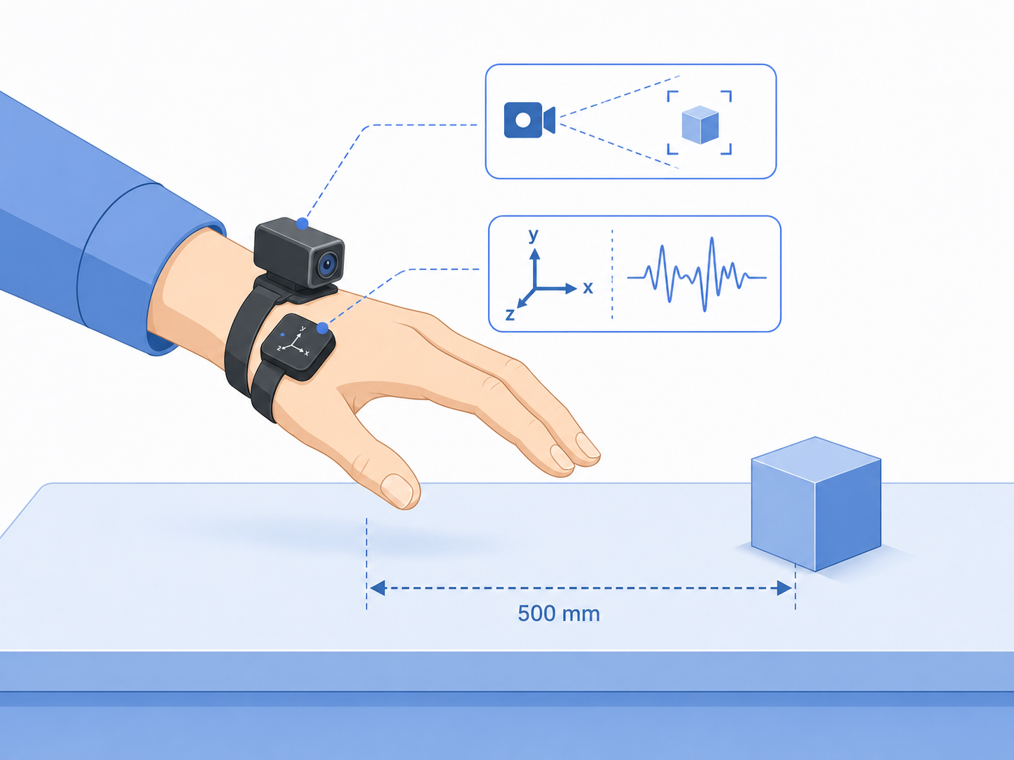
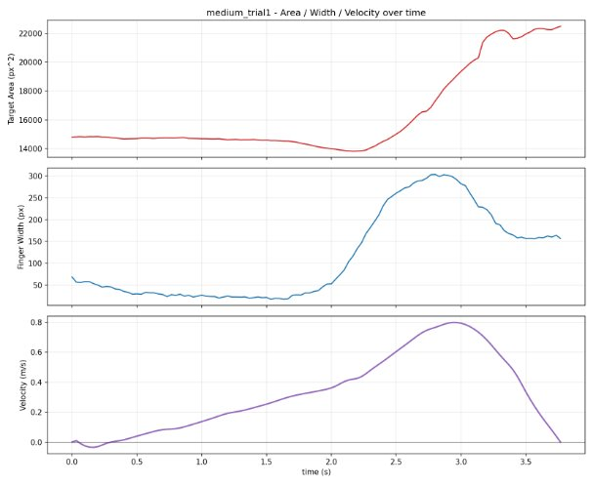

Slide 3
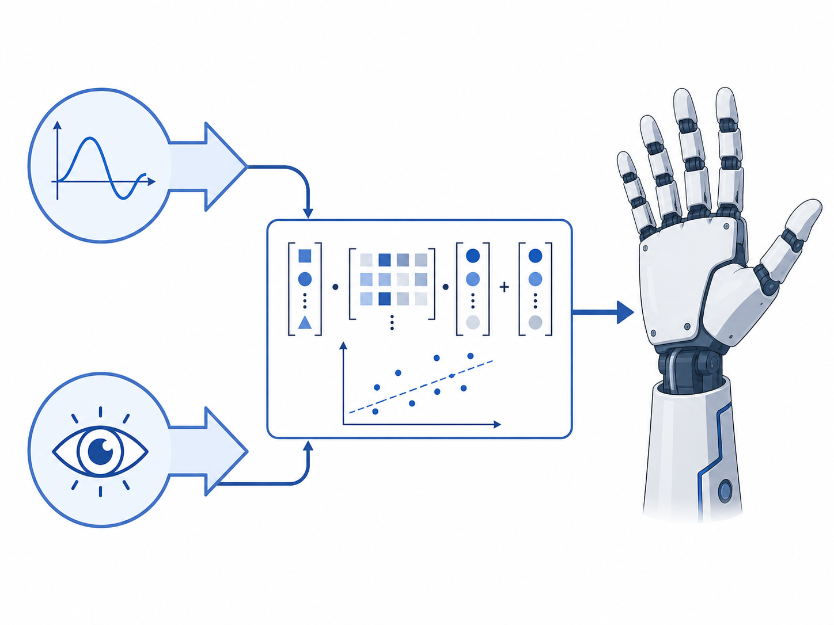
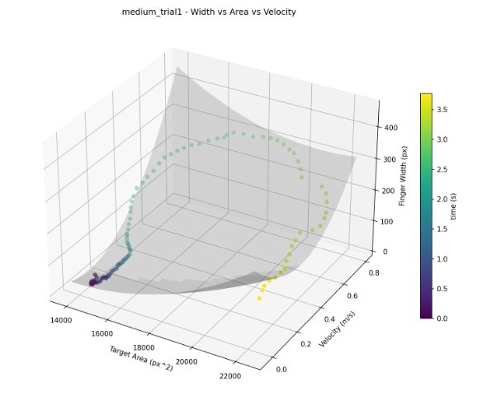

Slide 4
Regression Model
Object Size
Fingertip
Aperture
Acceleration

Slide 5
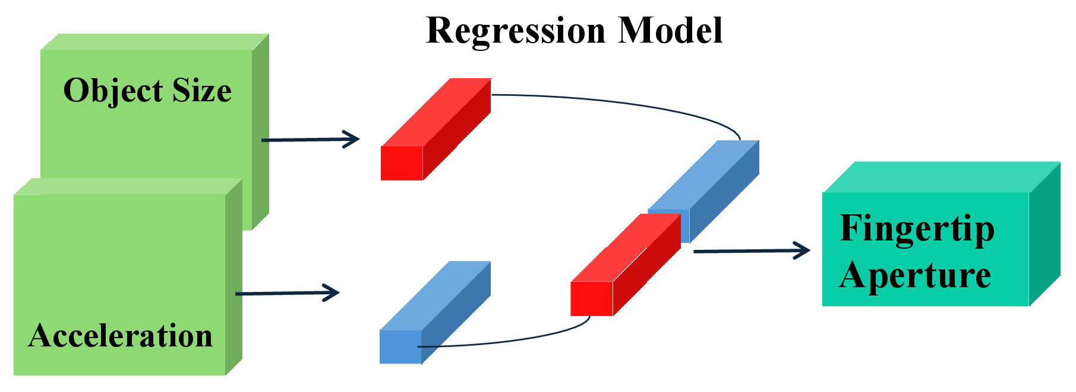
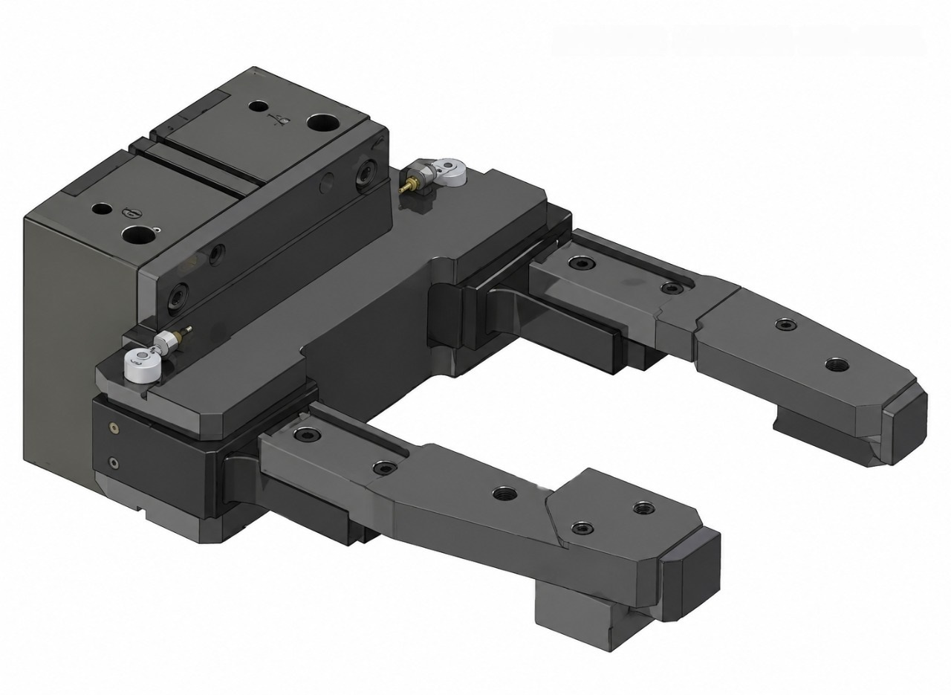

Slide 6
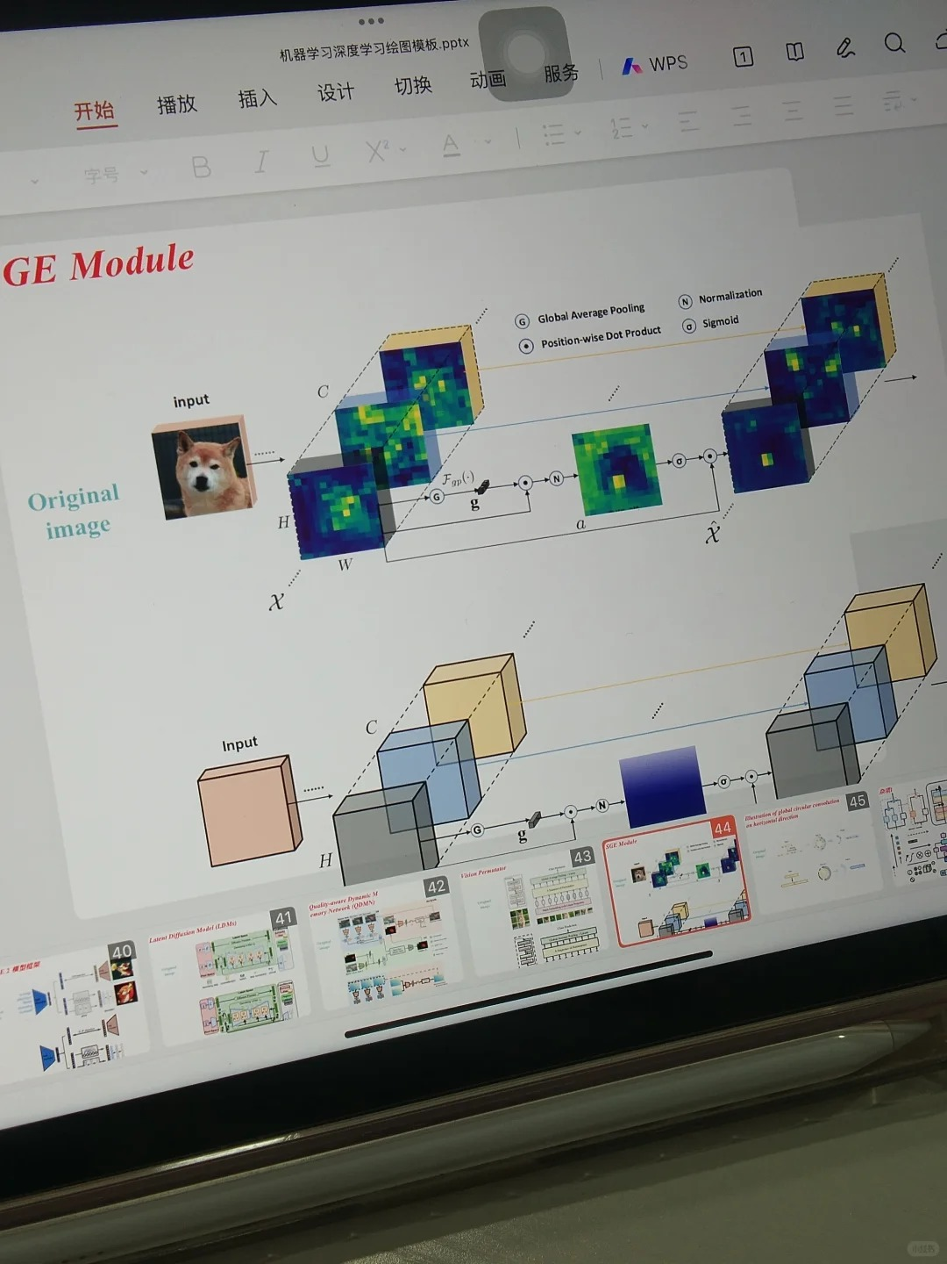
Inception Module
MaxPool Same s=1
5x5 Same
3x3 Same
NxNx192
1x1 Same
NxNx192
NxNx128
NxNx32
NxNx64
Notes:
Created by @srvmshr
Sourav @ yahoo.com

Slide 7
Size
Family?
X
Y
#bed
Walk?
PRICE ŷ
Basic Neuron Model
ZIP
School
Wealth
Ŷ = 0
How does NN work (Insprired from Coursera)
X
Logistic Regression
Ŷ = 1
Notes:
By @srvmshr
sourav@yahoo.com

Slide 8
